Slide 1



EDA LOAN STATUS PREDICTION
SUBMITTED BY:
Santhiya p
Nikitha R
Banu Priya.P

Slide 2
ABSTRACT:
In India, there are numerous risks related to the bank loans for both bankers and the customers for getting the loans because they are not able to predict or analyze whether the customer can payback the amount or not. So, Bank need to analyze their customers for loan eligibility so that they can specifically target those customers. Banks wanted to automate the loan eligibility based on customer details provided in their form. This project helps to predict the loan status and find out whether the person is eligible or not for loan application.

Slide 3
PURPOSE:
Loan prediction is always the threat to any financial institution. It should be predicted in earlier based on various features of the applicant. The main aim of the project is to applying machine learning models, including logistic regression, decision tree and random forest to classify applicant's and form a group of predicting variables, and evaluate the performance and also find the best accuracy between the model.
It is very much helpful to the bankers because if the transactions in banking sector is rapidly growing and huge data present, customer's behavior can be easily analyzed and the risks around loan can be reduced. It also found that regression models is the best model to classify those applicants and for easy predicting.

Slide 4
BASIC PROCESS:
DATA COLLECTION
DATA PREPROCESSING
MODEL BUILDING
FLASK

Slide 5
BASIC PROCESS:
DATA COLLECTION:
Dataset for loan prediction is collected from kaggle.
Data Preprocessing:
It is the process of cleaning, transforming and modelling data.
Model Training:
Logistic Algorithm is used for Model training.
Flask:
It is used for deployment.

Slide 6
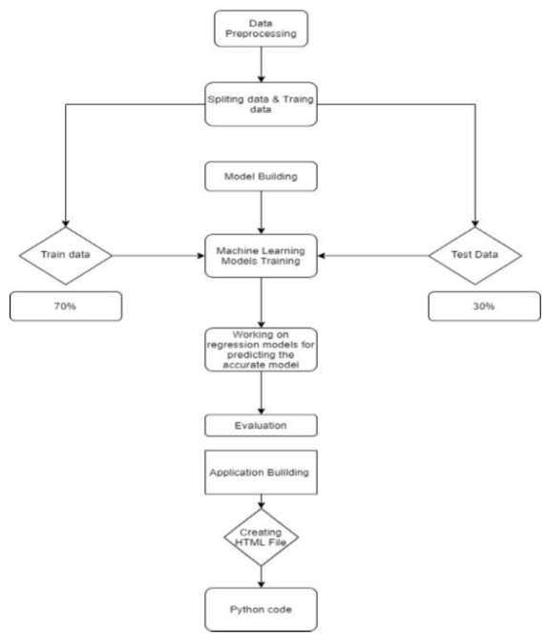
FLOW CHART:

Slide 7


ADVANTAGES AND DISADVANTAGES:
Using Machine learning to predict the loan status will produce high time and more accuracy in predicting the approximately close value can be done easily. It IS more trust worthy and cost effective .
It also reduces the man power for doing the experiments to find the strength of the concrete in different unknown situations.
There is a 3 % chances that the outcome will not predict the approximate value in that situation it can be troublesome.

Slide 8
FUTURE SCOPE:
This model can predict the outcome with many different inputs within seconds. So it helps tremendous growth in banking industry.
The model will save a lot of time of the Banking sectors and to employees. It helps in raise in banking sector.

Slide 9
THANK YOU

